Slide 1
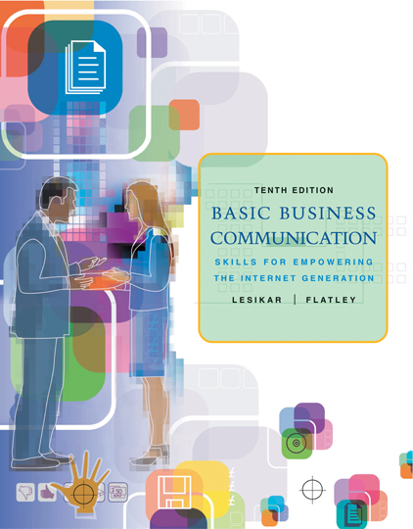

Slide 2

1
CHAPTER ONE
Communication in the Workplace
McGraw-Hill/Irwin
© 2005 The McGraw-Hill Companies, Inc. All rights reserved.

Slide 3
Overview
The importance of communication
Three forms of communication in business
Formal and informal networks
The process of communication
Basic truths about communication

Slide 4
The Importance of Communication Skills as Expressed by Business Authorities
“Top executives from Fortune 500 companies rate communications skills as the most important quality for business leaders.”
--Business Section
New York Times
“There may be no single thing more important in our efforts to achieve meaningful work and fulfilling relationships than to learn and practice the art of communication.”
--Max De Pree, Author
The Art of Leadership

Slide 5
Evidence of Communication
Weakness in Business
“I’m surprised how so many people struggle with communication.”
  --Michael Rook, Production Manager
  Hewlett Packard, San Diego, CA
“The first thing the Human Resources Department did was give me a writing book.”
  --Sam Reeves, IT Consultant
  AMS, Denver, CO

Slide 6
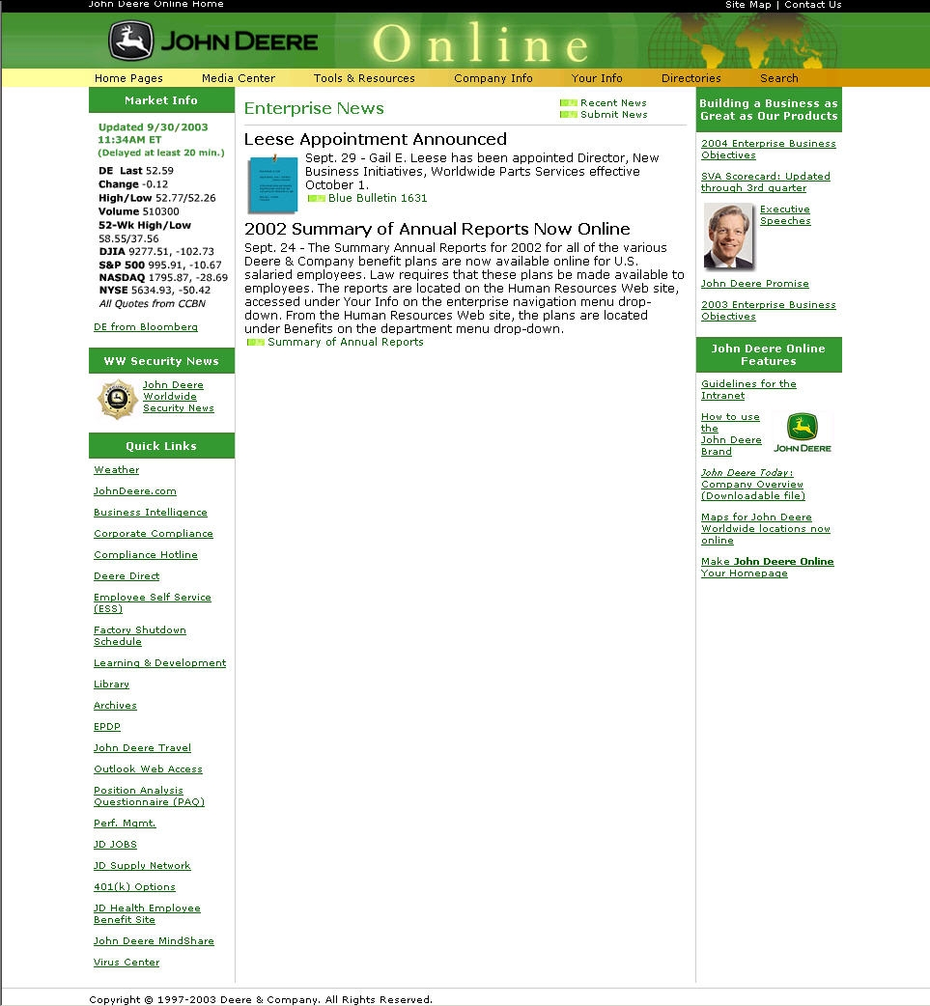
Main Forms of
Communication in Business
Operational
  Internal
  External
Personal
Intranets (or portals) like this one from Deere & Company are used for internal communication.

Slide 7
Communication Networks
Formal Network
  well-established, usually along operational lines
  planned
Informal Network
  complex
  dynamic

Slide 8
The Formal and Informal Communication Networks in a Division of a Small Manufacturing Company
Department
Manager
Supervisor
Supervisor
Black Solid Lines = Formal Network
Coral Dashed Lines = Informal Network (at a moment in time, for they change often)

Slide 9
Factors Affecting Volume of
Communication in Business
Nature of the business
Operating plan
People

Slide 10

A Model of the Communication Process
sensory world
sensory world
--medium--
Kelly
Justin

Slide 11
How Oral and Written
Communication Differ
Written communication
is more likely to involve creative effort,
has longer cycles,
and usually has fewer cycles.

Slide 12

Adaptation

Slide 13
Some Basic Truths about Communication
Meanings sent are not always received.
Meaning is in the mind.
The symbols of communication are imperfect.

Slide 14
“Writing is thinking on paper. Anyone who thinks clearly should be able to write clearly about any subject at all.”
--William Zinsser, Author
On Writing Well

